Slide 1

by Muhammad Al Farizi

Slide 2
Table of Contents
The Big Idea
Competitive Analysis
Our Dream Team
Financial Plans
Marketing
Making a Difference

Slide 3
Let’s face it, finding a parking spot in real-time
can be a total nightmare.
Imagine rushing to an important meeting, heart pounding,
as you approach your destination.
The last thing you want to worry about is finding an elusive
parking spot. Will you make it on time?
We all have been there, and it’s frustrating.

Slide 4
The problem
Finding parking spaces in busy areas can be a challenge
The solution/Our Goal:
An app that simplifies the process of finding real-time parking spots

Slide 5
Introducing a simple and elegant solution..

Slide 6
The Big Idea
The idea behind ParkWise is to create a user-friendly solution for the increasing demand of parking in busy areas of Budapest. Activity Domain: Transportation
Features of the app.
Leverages real-time data from parking
garages and street parking
Provide users a comprehensive view of available
spaces in the area (pricing and traffic conditions)
Help drivers save time and reduce stress

Slide 7
Our Unique Selling proposition.
Ability to reserve in advance
Notifications for upcoming parking expiration times
Pay directly within the app
Loyalty program + discount code.

Slide 8
The plans for ParkWise are to expand the app to cover additional cities and integrate with more parking facilities to provide even more accurate and up-to-date information, and to increase its visibility within the community.

Slide 9
Our plan collaboration partners:
Budapest Transport Center (BKK).
ParkWise could integrate the app with existing public transport system.
This provides seamless experience to finding spots near public transit stations
Major Shopping centers/event venues. (Westend, Arena Plaza, Váci street)
Allows ParkWise to reserve parking spots in advance for busy shopping
days/event venues, this benefits both parties by providing more convenient and
stress-free parking experience for the customers.
Parking facility management companies. (ParkOne, Budapest Parkoló Zrt.)
PakWise offers comprehensive view of garage and street parking, increasing
visibility and demand for their parking facilities.

Slide 10
To Validate our Idea, we plan to:
Conduct user testing
Gather feedbacks from early adopters
Partner with local business and organizations to increase visibility

Slide 11
Competitive Analysis
Similar solution: Parkl
The app, however, is moderately difficult to use, provides outdated information, offers complicate booking process, and lacks of helpful features.

Slide 12
FIVE FORCES MODEL ANALYSIS
Threat of new entrants: Moderate. The cost of developing the app may not be high, but building reliable and accurate real-time parking database could be challenging.
Bargaining of suppliers: High. The app relies on accurate and up-to-date available parking spots.
Bargaining of buyers: Low. There are not many app alternatives available in Budapest.
Threat of substitutes: Moderate. There are other parking apps available, but they don’t provide the same level of convenience and accuracy as ParkWise.
Competitive rivalry: Moderate. There are sufficient established players in the market.

Slide 13
BENCHMARKING ANALYSIS
ParkWise could be benchmarked against similar parking apps based on factors such as:
User interface and user experience
Accuracy and reliability and the parking data
Availability of parking spot information in real time
Pricing and payment options
Integration with other services such as navigation and payment platforms

Slide 14
STEEPLE/PESTER ANALYSIS (THE IMPORTANT ONES)
Political/Legal:
Regulations and permits related to parking managements
and safety standards
Government initiatives and policies related to sustainable transportation
Legal challenges related to liability and insurance for parking-related accidents

Slide 15
Our Dream Team
Team roles and experience:
Software development experts. Skills : Java, Python, Swift
UI/UX designers. Skills : Sketch, Adobe XD, Figma
Marketing experts. Skills: Market research, Data analysis
Business experts. Skills: partnerships with stakeholders
Prior Knowledge:
Experience in parking management
Understanding of local parking regulations
Knowledge of parking technology landscape

Slide 16
Market knowledge is important for ParkWise to understand target audience, competition, and overall market dynamics.
In terms of social capital/partnerships, these are important.
Partnerships with parking lot operators
Partnerships with property managers or businesses

Slide 17
Financial Plans
Main Financial Resources for seed and early stages:
Personal savings
Friends and family investments (equity/debt)
Angel investments
Seed funding from venture capital firms
Elements of Financial planning in ParkWise’s early stage:
Identifying costs (app development, legal fees)
Estimating cash burn rate
Determining composition of financing (funding wisely)
Estimating total financing needs (taking account costs)

Slide 18
ParkWise Forecast of Main Revenues.
The revenues will come from commissions charged on each parking spot booked through the app. The revenue forecast will depend on:
Number of users
Number of listed parking spots
Commission charger per booking
We will conduct market research and analysis to estimate further

Slide 19
Marketing
Target Audience: urban car drivers (25-54)
Our plan to advertise ParkWise:
Social Media advertising
Content marketing (Blogs)
App store/Google Play Optimization
User testing (Gathering feedbacks)
Word-of-mouth (Referral programs)
Our marketing strategy centers around one goal: Customer satisfaction

Slide 20
Making a Difference
ParkWise takes socially responsible approach in several ways:
Environmental impact: Encourage drivers to use available parking spots rather than circling around looking for spots. This reduce traffic congestion and emissions.
Accessibility: Designing app with accessibility features (adjustable font sizes, screen readers, color contrasts) to ensure the app’s user interface is accessible to people with disabilities
Data Privacy: ParkWise ensures that user’s information and payment details are stored securely and only used for intended purposes. The company will be transparent about its data practices and promises to provide clear information about data usage

Slide 21
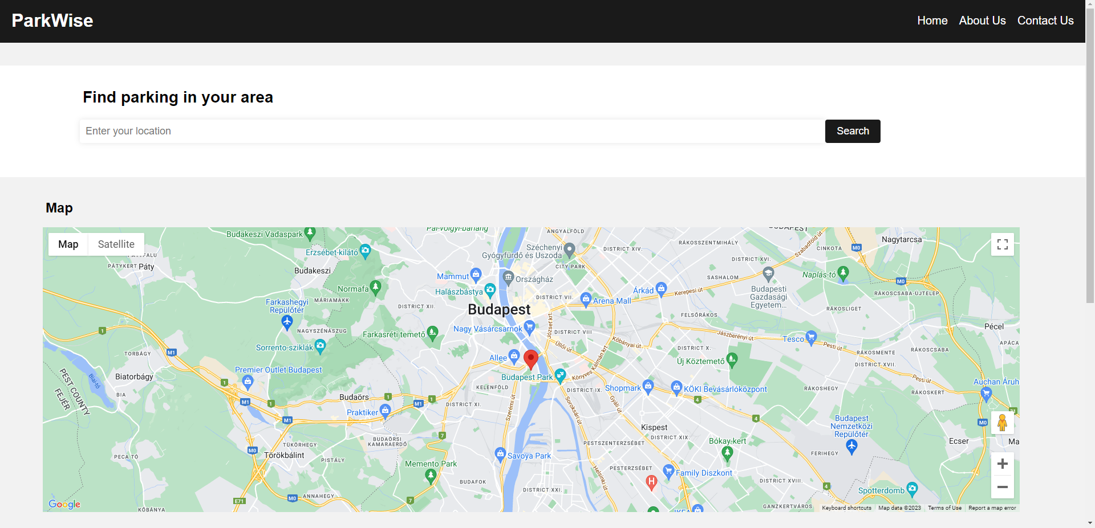
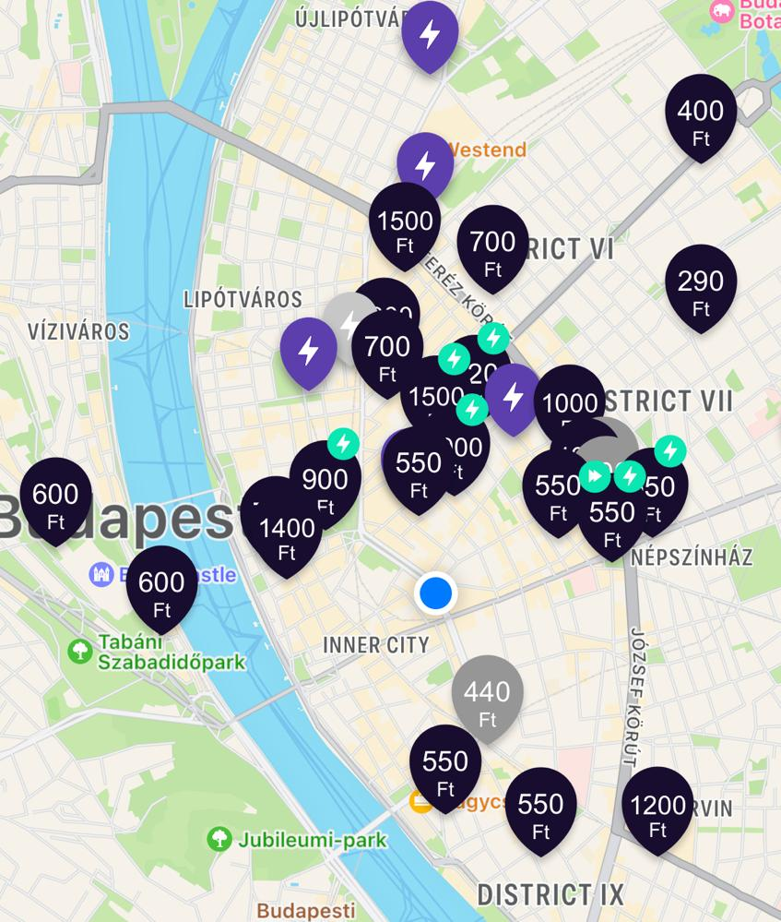
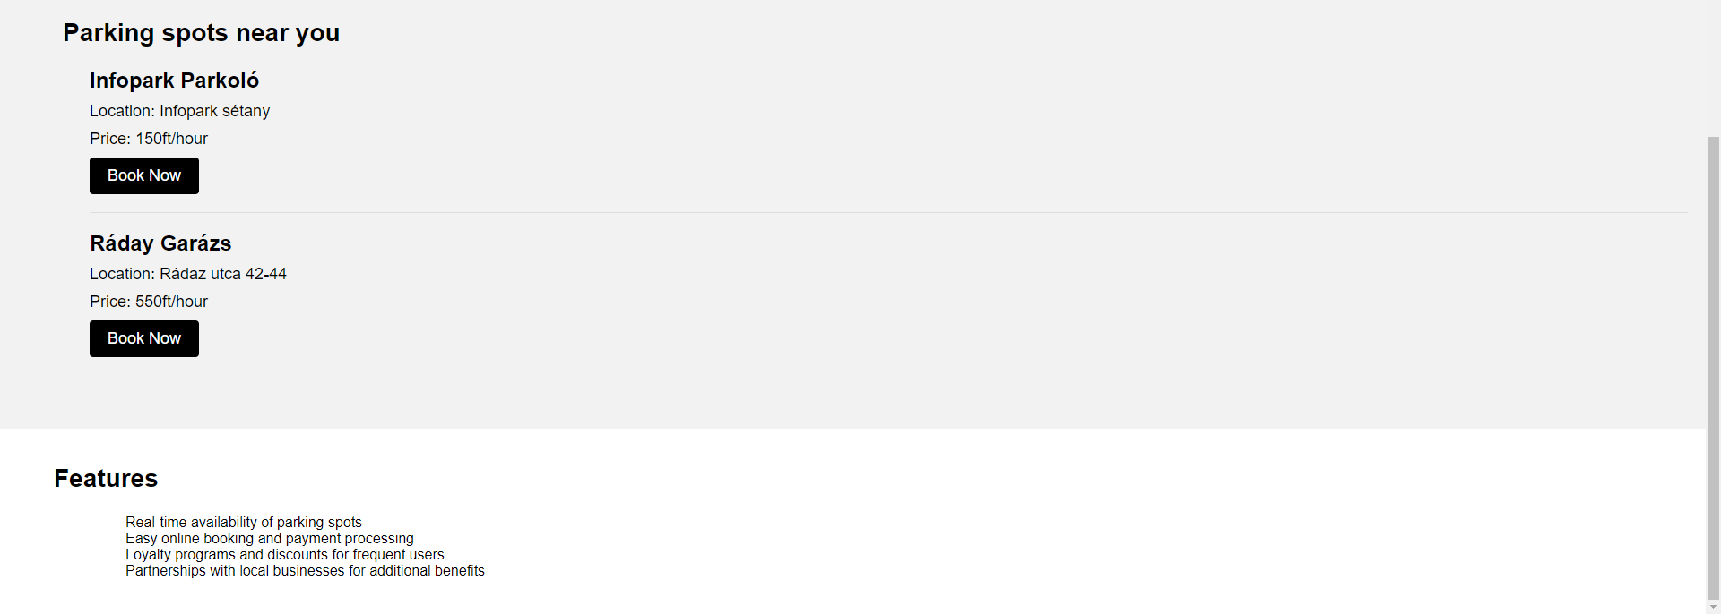
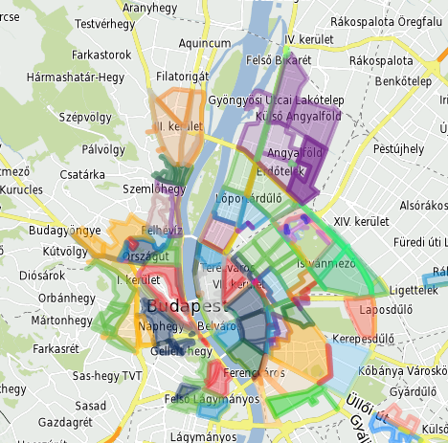
A website prototype of ParkWise

Slide 22
Parking made simple –

Slide 23
by Muhammad Al Farizi

